Slide 1

FCS 2020 Crisis Call Analysis
DDA-3
April 13, 2021

Slide 2



Overview
The Ask
Data Cleaning Process
Data Analysis
Key Insights
Q & A

Slide 3
The Ask

Slide 4


Business Questions
Examine call volume and identify surge times/seasons/events
Analyze trends in call content
Most common issues
Average count of issues per call
Assess regional and demographic trends in call content and call volume
Determine count and success rate of imminent risk calls
Identify potential savings in avoided ER visits and psychiatric treatment

Slide 5
Data Cleaning Process

Slide 6
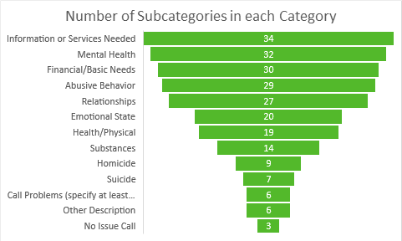
Methodology used for data findings
Our area of focus are the 2020 Crisis Issues columns provided by FCS.
FCS agents select issues from categories during each call which are aggregated into columns.
By using a string method in python, Crisis Issues columns were separated and each sub issue was set in its own respective column.
Columns denote values of 1 when the issues were present and values of 0 when they were not.
We added total columns for each sub issue and two columns if the calls were of Imminent Risk (IR) and how many Imminent Risk issues were present in each call.
Notes:
We wanted to focus on 2020 Crisis Issues columns that highlight issues for the caller from the data given to us by FCS.
Each column had a number of sub issues that the agent could select from the larger issues during each call.
To accomplish this we took each of the Crisis Issues columns and separated them using a string method in python, and then by setting each sub issue as its own respective column.
The columns denote values of 1 when the issues were present and values of 0 when they were not in each call.
We then added totals columns for each sub issue and two columns to show if the calls were of IR and how many IR issues were present in each call.
This allowed us ability for a deeper analysis to find trends in areas we felt we could use to help FCS target additional funding.

Slide 7
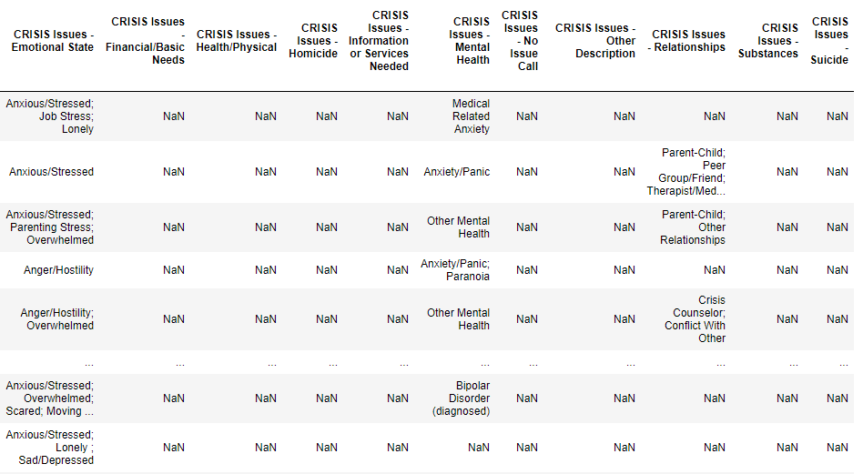
Before:

Slide 8
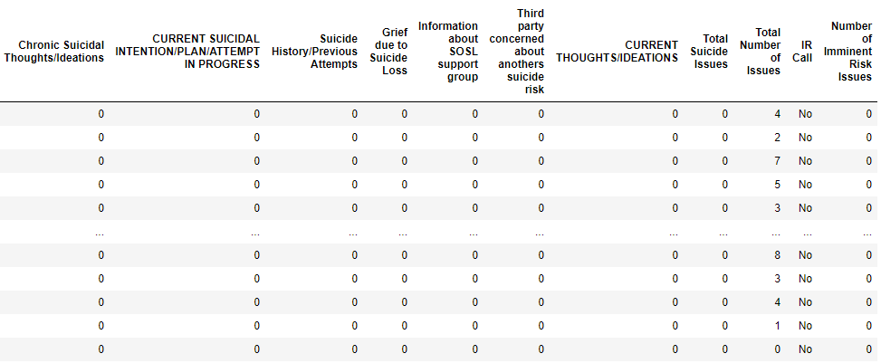
After:

Slide 9
Data Analysis

Slide 10
Analysis by Time

Slide 11


Key Considerations
Identify peaks in call volume based on:
Season
Holidays or current events
Times of day
Days of week
Compare 2020 call volume to 2019
Examine imminent risk call volume
Notes:
We looked at call volumes by season | month | daily | times of day

Slide 12
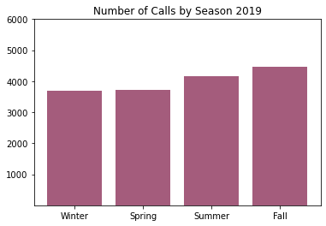
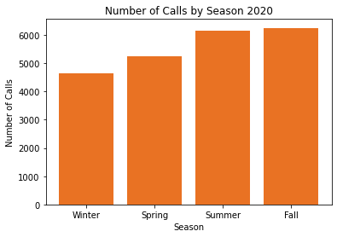
Calls by Season 2019 vs 2020
Death of Kobe Bryant
First US case of COVID-19
Beginning of election year
All seasons in 2020 had higher number of calls compared to 2019
Fall 2020 had 69% increase in calls compared to Fall 2019
Notes:
Orient to charts
All seasons higher 2020
With Fall having highest increase

Slide 13
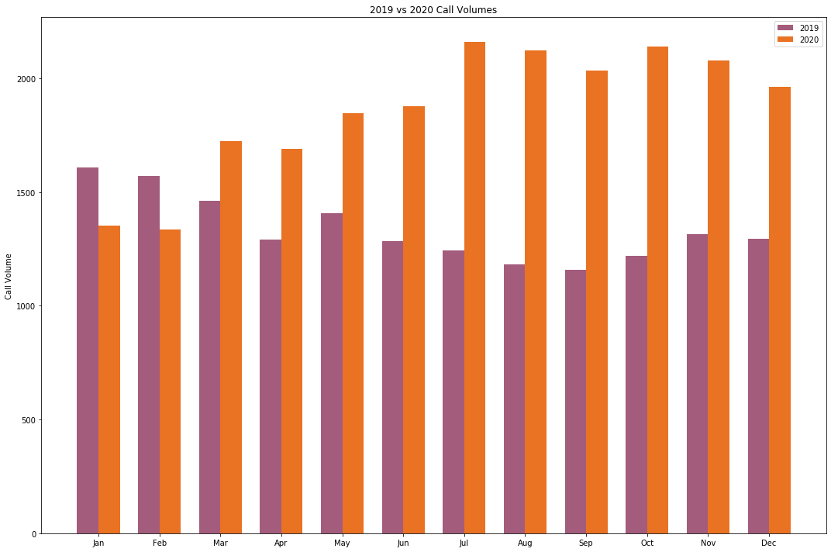
Call Volume 2019 vs. 2020
2020 call volume greatly exceeded 2019 call volume from March through December.
Increased call volume was not tied to discrete events, but rather increased throughout 2020 from March onward
Notes:
Orient to chart
Jan and Feb were the only months with higher volumes in 2019, beating out 2020 by a few hundred calls each
We can see how much higher each month is in summer and fall

Slide 14
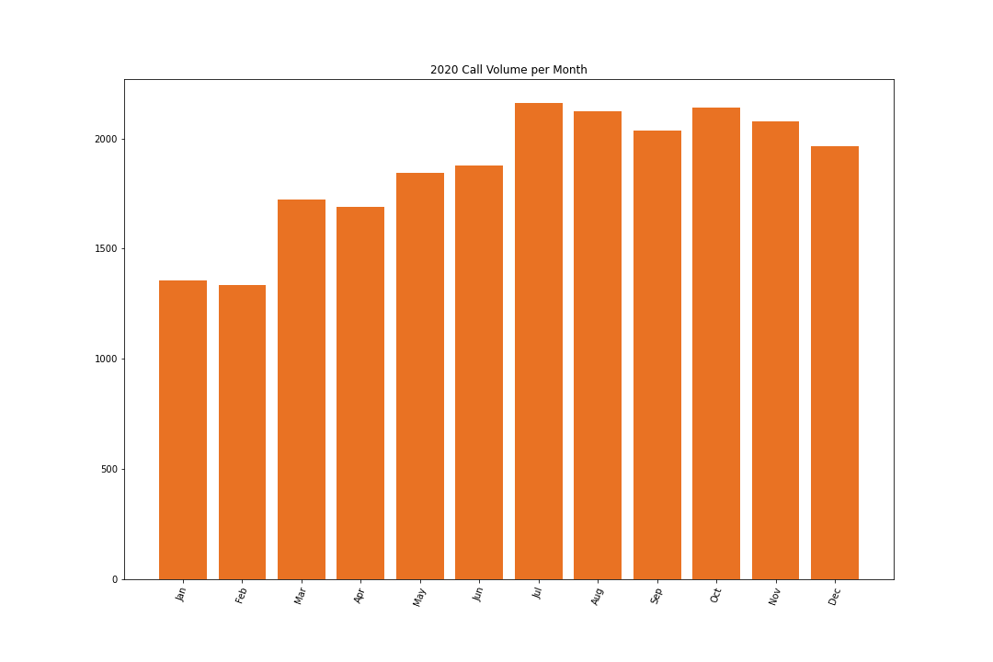
2020 Call Volume by Month
March 2nd - Nashville Tornado
March 13th - Covid19
April 2nd - TN Stay-at-Home Order
November 4th - Presidential Election
November 7th - Election Called
May 25 - George Floyd killed
BLM protests begin - largest nationwide protests in the history of USA
December 25th - Bombing in Downtown Nashville
Covid ongoing
Protests ongoing
September 29 - First Presidential Debate
Election Season in full swing
October 2nd - President contracts Covid19
October 22nd - Second Presidential Debate
Still Protests
Still Covid
Notes:
Looking 2020 we’re going to give a high level overview of the events that happened throughout the year
July 2,160
Oct 2,139
Aug 2,122

Slide 15
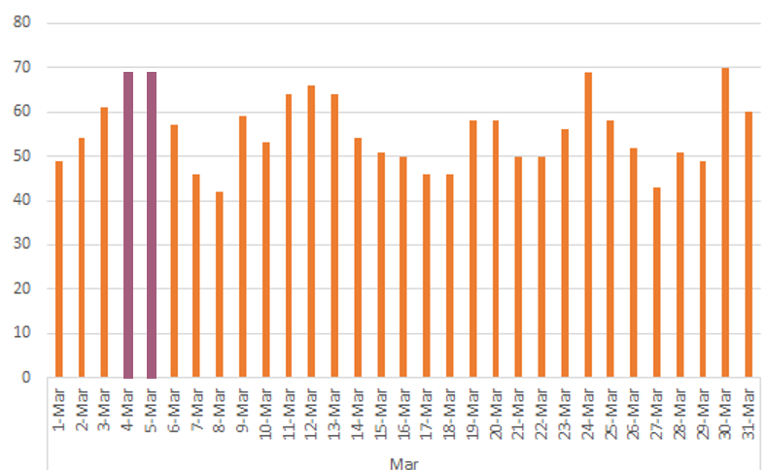
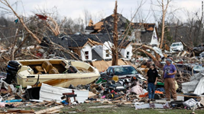
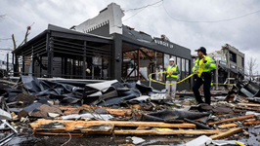
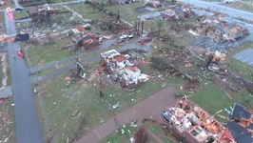
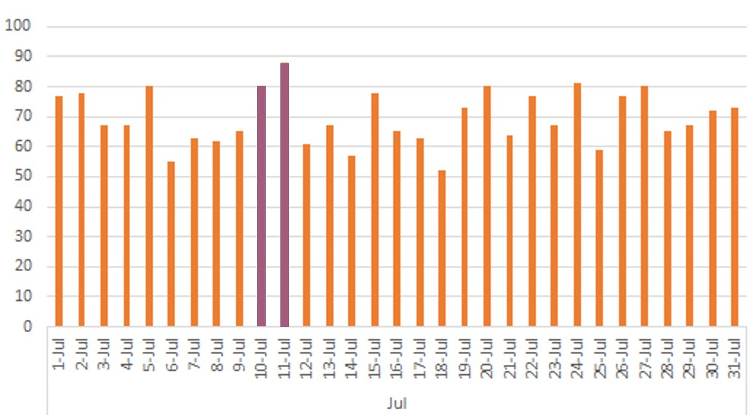

Call Volume Increase due to severe weather
Severe storms and at least one tornado on March 2, 2020 triggers an increase in call volume between March 4th and March 5th
Due to severe weather impacting 20 county jurisdictions on Friday, July 9, 2020 we see an increase in calls on July 10th and July 11th.
Notes:
Orient to charts - Show daily volumes in march as example
This slide indicates a rise in call volume on March 4th and March 5th due to Tornadoes and severe thunderstorms
However, while we did see an increase in calls, this hold to a pattern of weekly
There is another increase between July 10th and July 11th due to another Tornado

Slide 16
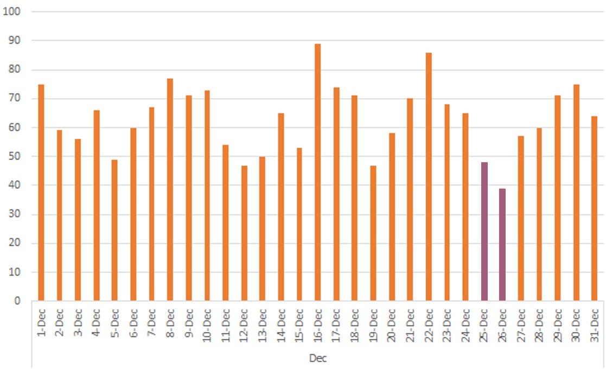
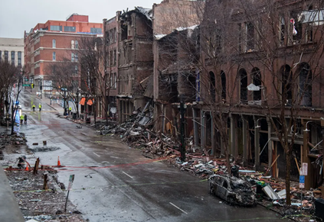
Call Volume decrease due loss of cell service
On Friday, December 25, 2020 6:30AM Anthony Quinn Warner detonated a vehicle bomb in downtown Nashville, Tennessee, United States, killing himself, injuring eight people and damaging dozens of buildings in the surrounding area.
It took place at 166 Second Avenue North between Church Street and Commerce Street at 6:30 am, adjacent to an AT&T network hub, resulting in days-long communication service outages.
Notes:
Here we see a decrease in call volume on December 25th and December 26th due to service outages caused by a vehicle bomb

Slide 17
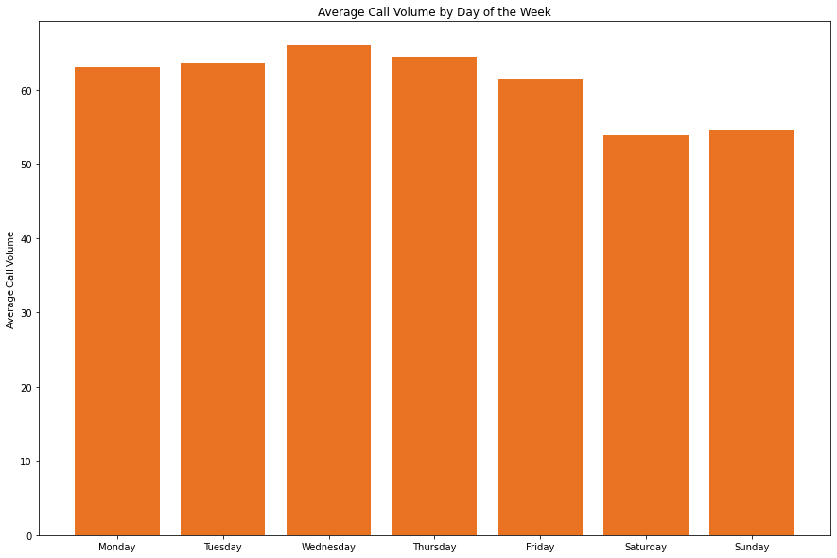
Average Count of Calls by Day of the Week
Average weekday call volume: 64 calls per day
Average weekend call volume: 54 calls per day
Weekday call volume exceeds weekend call volume by 18.5 %
Notes:
Orient to chart!
Weekday calls: 71.58%
Weekend calls: 28.41%

Slide 18
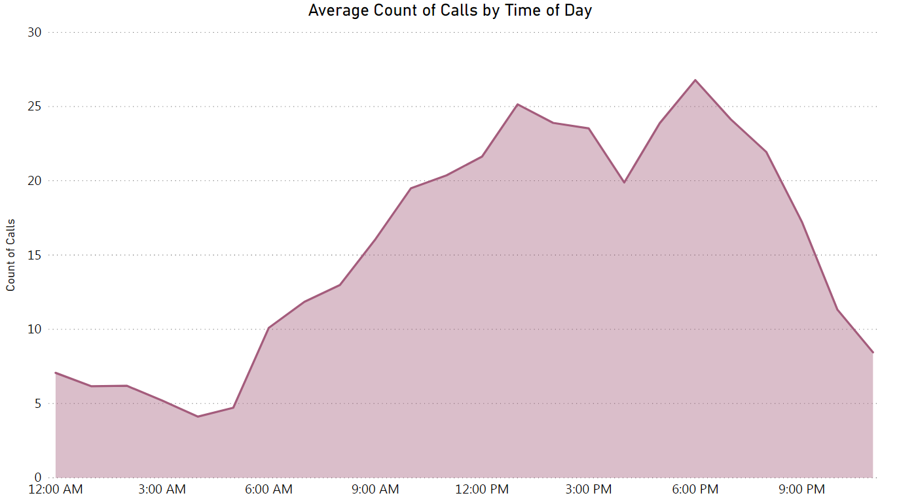
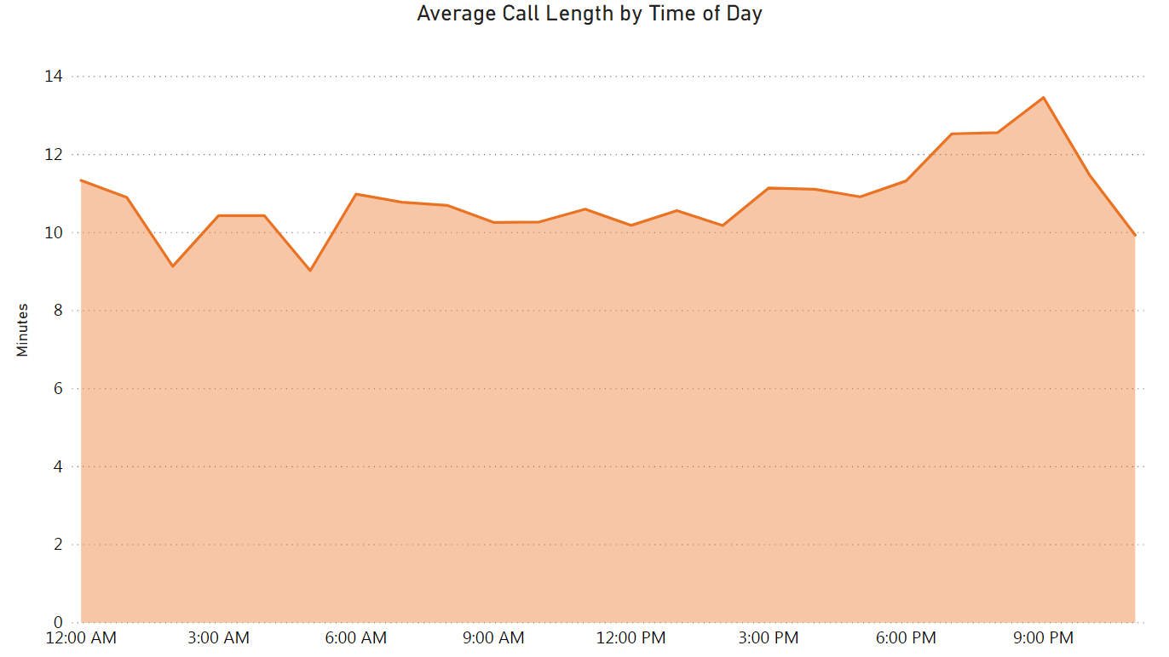
Calls by Time of Day
Most calls fall between 6:00 AM and 9:00 PM, with peaks around 12:00 PM and 6:00 PM
Calls average 10 minutes in length, regardless of time of day

Slide 19
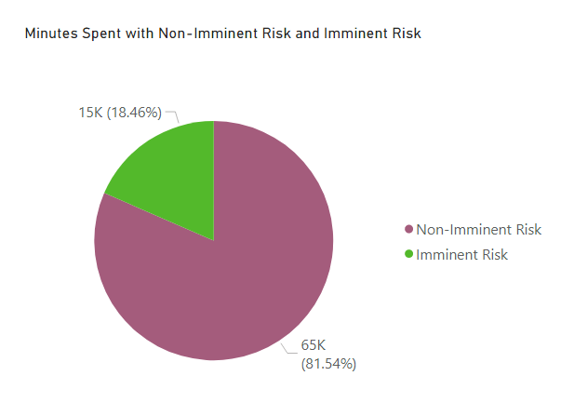
Imminent Risk Call Volume
Total Minutes spent with Non-Imminent Risk Calls - 65,276 minutes
Total Minutes spent with Imminent Risk Calls - 14,781 minutes
Notes:
Last thing to highlight is the imminent risk category. This is something we’ll dig into more later but I wanted to highlight Within these call volumes we found that 18% of the total time spent on calls were with imminent risk issues

Slide 20
Analysis by Call Content
Notes:
Need to figure out what to call this section.

Slide 21

Key Considerations
What issues are most common?
What kinds of issues (crisis categories) are most prevalent?
Are there differences in issues reported in 2019 vs. 2020?
What issues are imminent risk callers reporting?

Slide 22
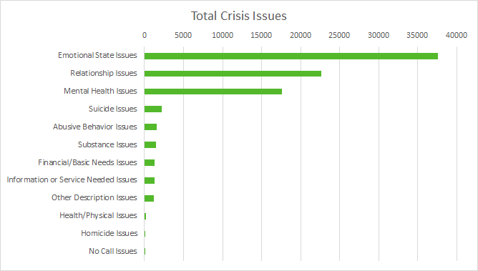
Issue Count by Crisis Category
Top 3 Crisis Categories:
Emotional State: 37,613 issues reported
Relationship Issues: 22,689 issues reported
Mental Health Issues: 17,652 issues reported
Notes:
Each Crisis Issue category has subcategories mentioned on the previous slide. Of all issue categories we found a majority of callers reported within the
Emotional state issues - Anxious/Stressed 10,094 (approx 27% of Emotional state category), Overwhelmed 5,518 (15%), Sad/Depressed 4,883 (13%)
Relationship issues - Family 4,393 (19%), Conflict with Other 3,303 (14%), Other Relationships 2,286 (10%)
Mental Health issues - Anxiety/Panic 4,300 (10%), Depression 3,478 (8%), Other Mental Health 2,195 (5%)
*could/should time be added to this one as well? -Nicole

Slide 23
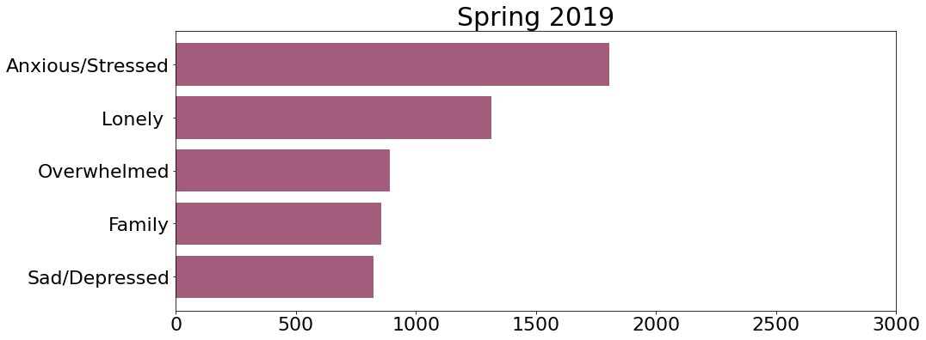
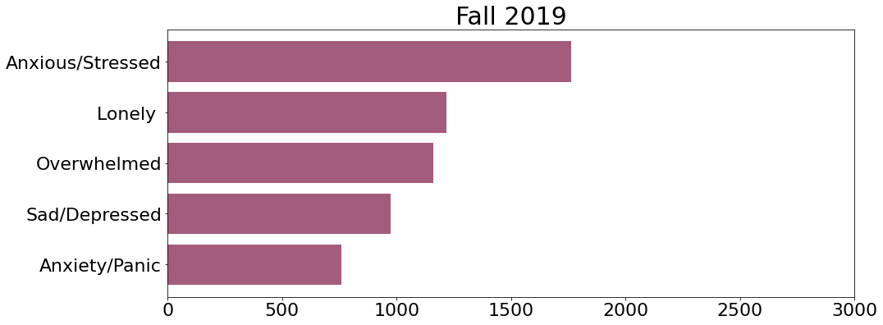
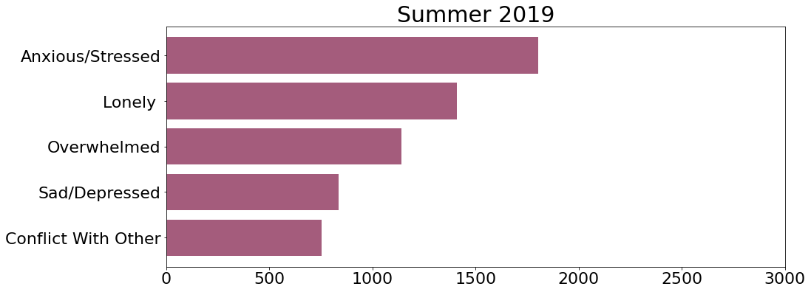
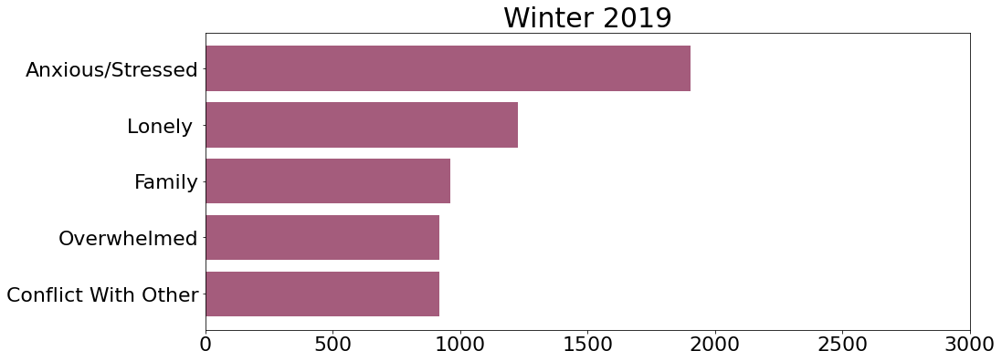
Most Prominent Issues 2019 v 2020

Slide 24
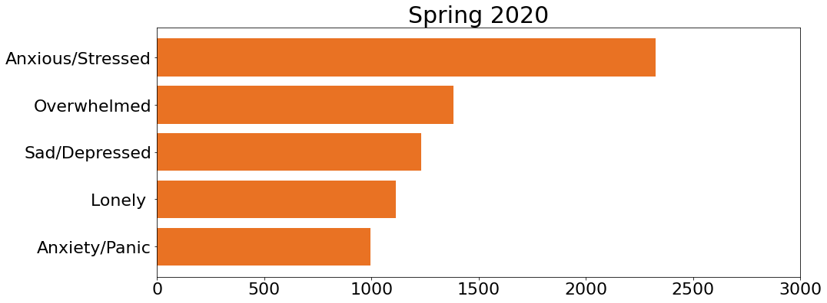
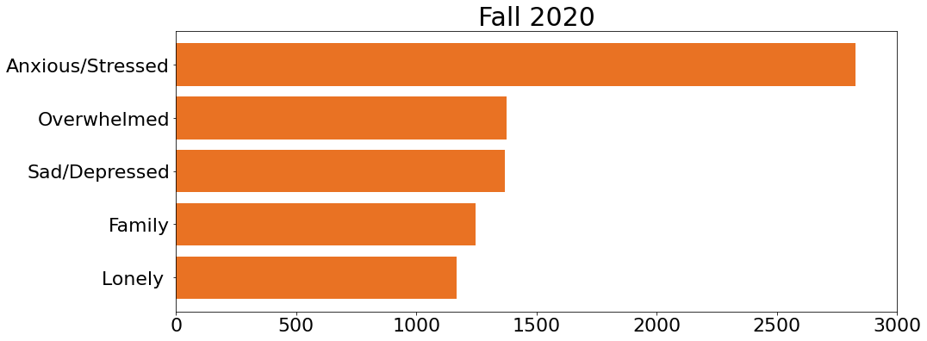
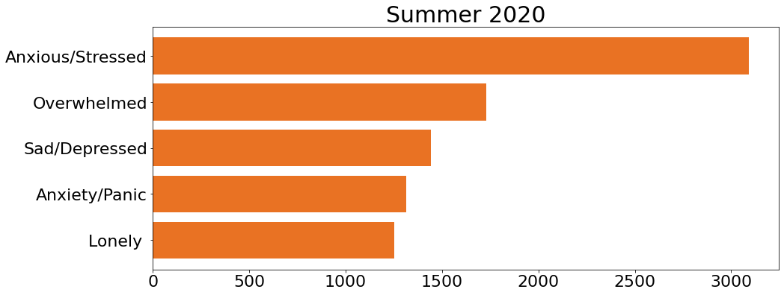
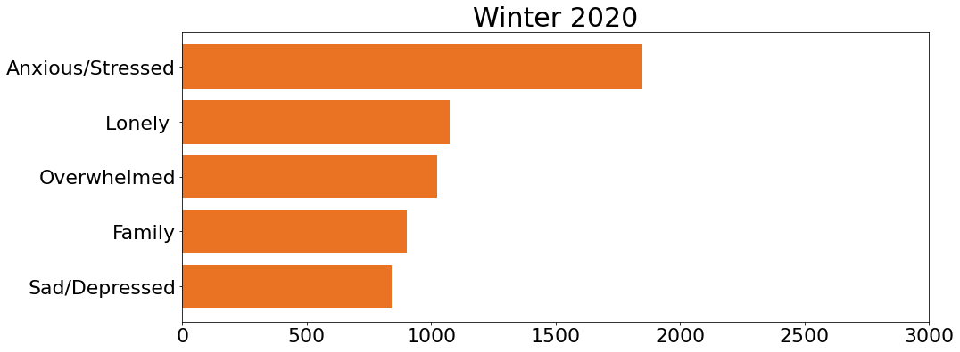
Most Prominent Issues 2019 v 2020
Notes:
Fonts need to be much larger.
Need to enter argument color = ‘#53B92B’ (or one of the other colors) to the plt.barh

Slide 25
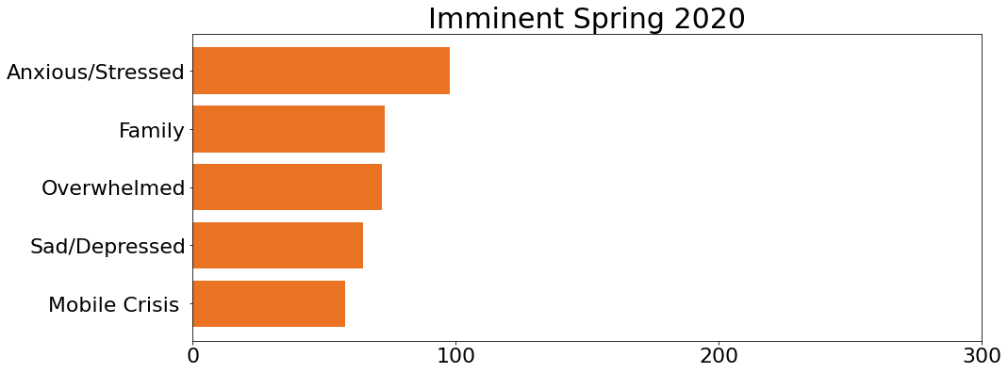
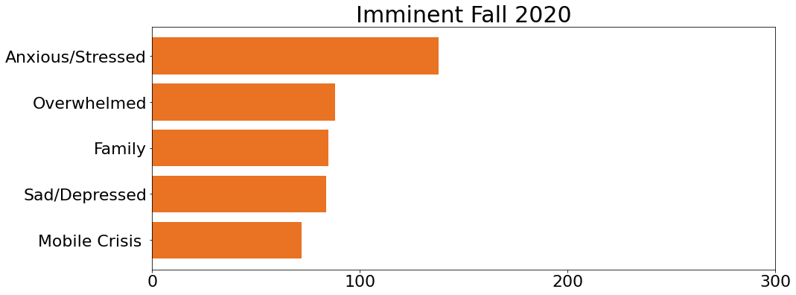
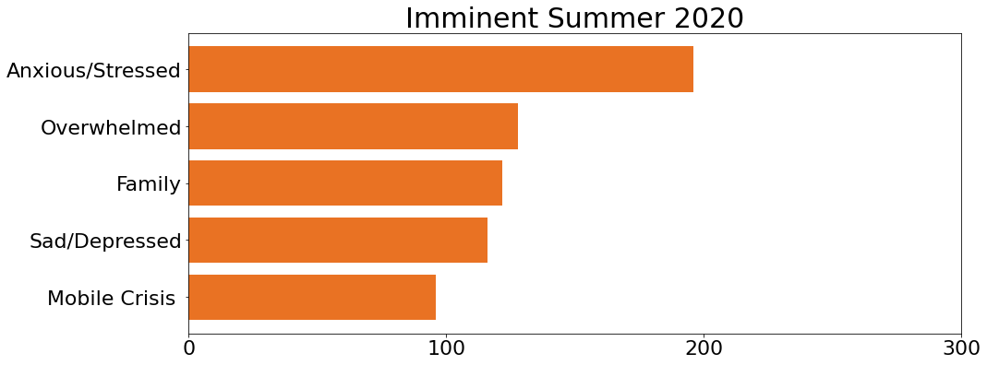
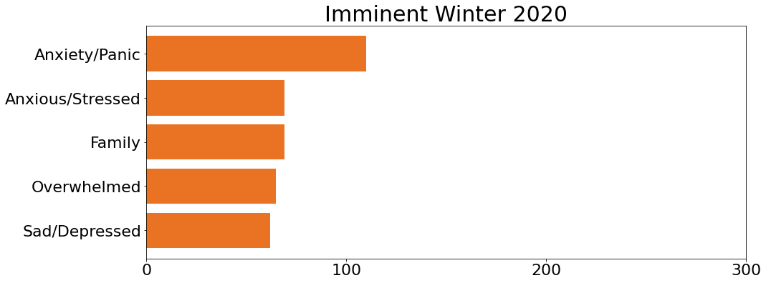
Most Prominent Issue Types for Imminent Risk Calls

Slide 26
Geographic Analysis
Notes:
Moving forward we’re considering the spatial aspect of the data.

Slide 27

Key Considerations
How many callers are from out of state?
What counties in Tennessee have the highest call volume?
Which counties have the highest volume of imminent risk calls?

Slide 28
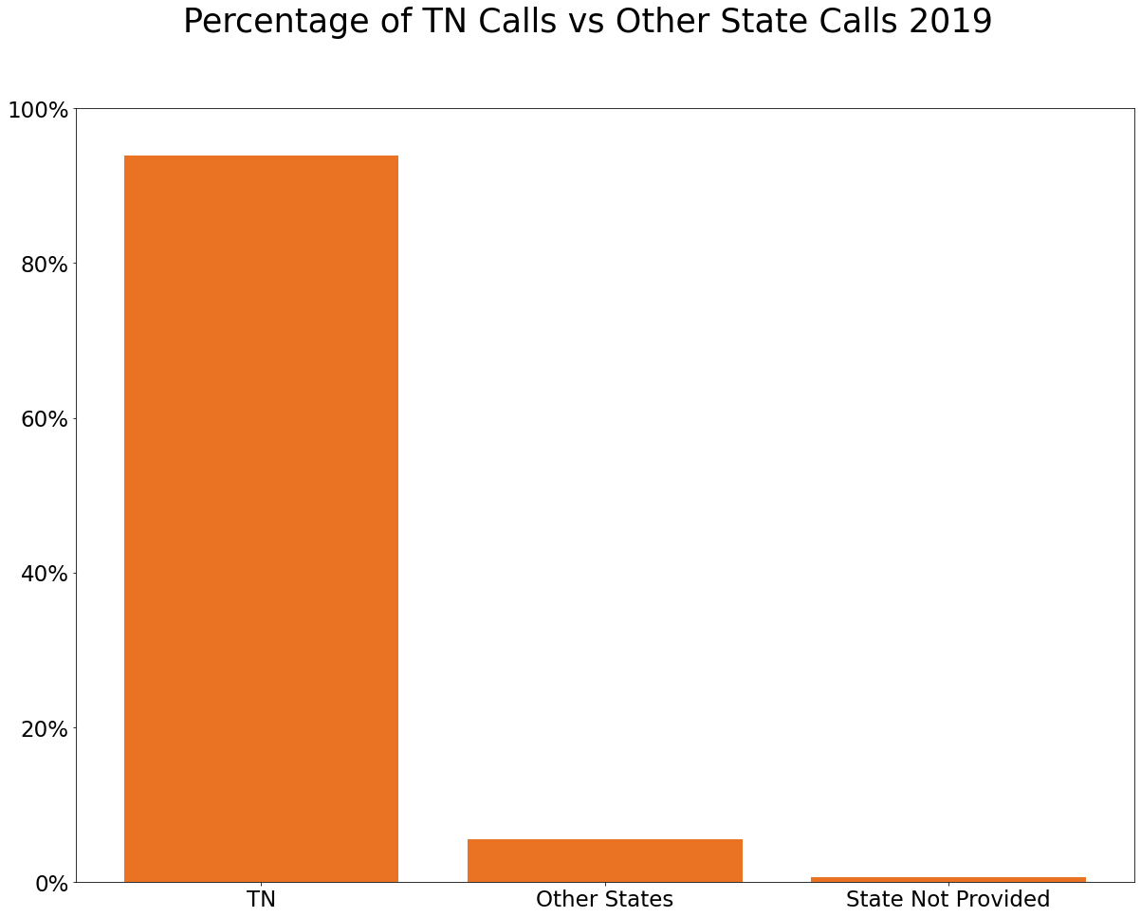
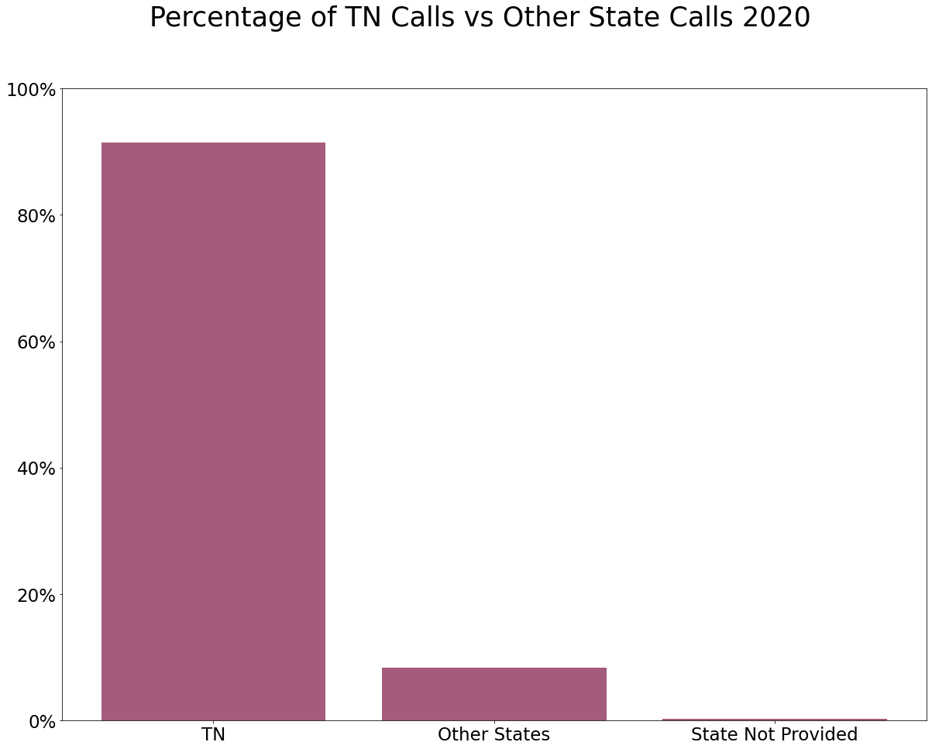
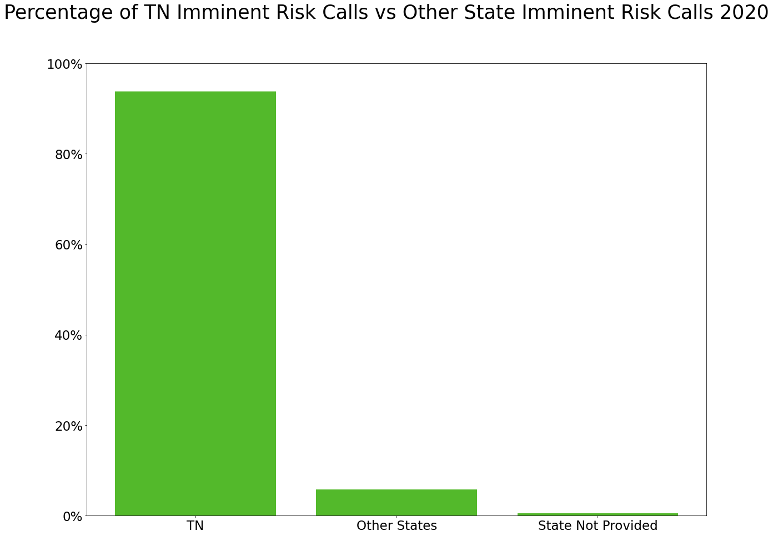
TN Calls vs Other State Calls
For 2019, roughly 6% of all calls answered were from other states/unknown
For 2020, roughly 9% of all calls answered were from other states/unknown
In 2020, roughly 6% of all imminent risk calls answered were from other states/unknown
~6%
~9%
~6%
Notes:
Consider moving this up to other slides about out of state stuff.

Slide 29
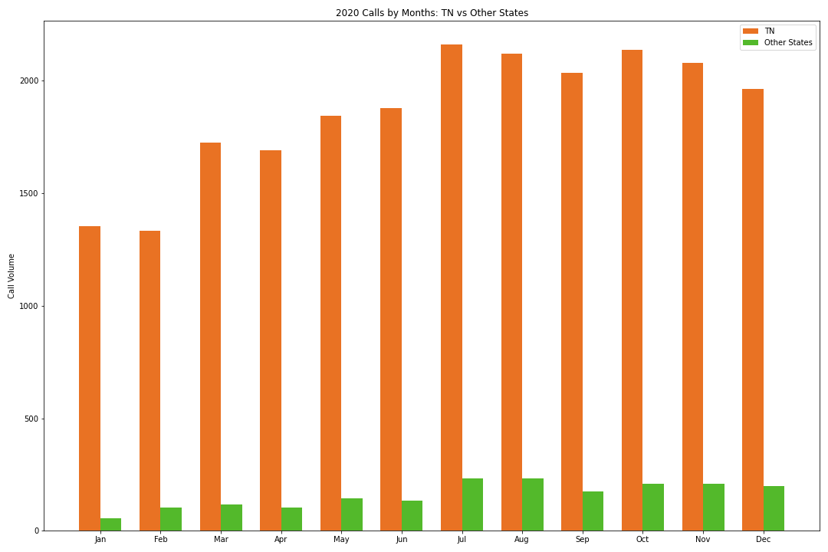
2020 Calls by Months: TN vs Other States
Out of state call volume increased throughout the year, with July and August seeing the highest peaks of out of state calls (231 each in July and August, versus 144 in May and 135 in June)
Top 3 out of state locations:
Wisconsin: 350 calls
Texas: 227 calls
Minnesota: 132 calls
Notes:
Highest: TN only July 2,160 Other July/Aug 231
Lowest: TN only Feb 1,335 Other January 55

Slide 30
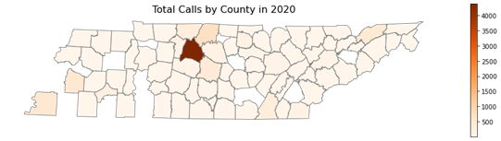
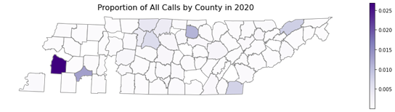
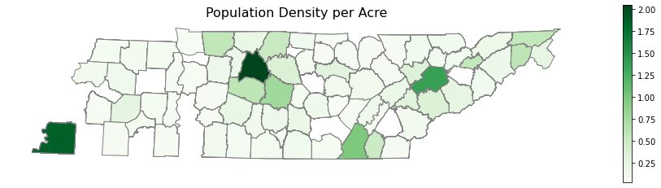
Tennessee by County: All Calls
Davidson County has the most reporting of all calls by far.
When this is normalized by population, Haywood county stands out, as well as Chester, Robertson, Sumner, Davidson, Jackson, Polk, and Hawkins counties.
Population density is included for reference and comparative purposes.
Notes:
This is cool. -brandon - ty brandon
Map1: The geospatial analysis begins with a visualization of where most calls are coming from. Perhaps unsurprisingly, due to the large population, most calls in 2020 came from Davidson County. However, we want to know more than where the most people live, we want to understand what communities have high rates of calls. So the second map shows the total number of calls normalized by population, with total population density below that for reference. This can tell us whether more calls are coming from relatively urban or rural communities, for example. When we do normalize by population, we see Haywood county standing out, as well as Chester, Robertson, Sumner, Jackson, Polk, and Hawkins Counties. Davidson still stands out even when we normalize.

Slide 31
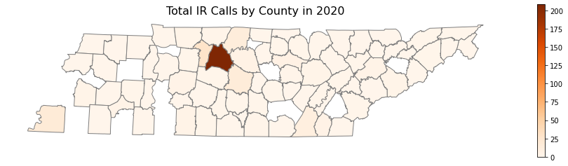
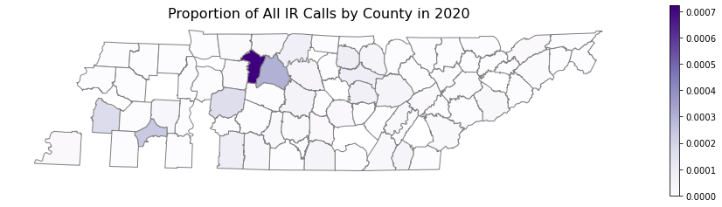
Tennessee by County: All Imminent Risk Calls
Davidson County has the most imminent risk calls by far.
When this is normalized by population, Cheatham county pops out. We also see Davidson, Haywood, Chester, and Hickman counties.
Population density is included for reference and comparative purposes.
Notes:
This is cool. -brandon - ty brandon
Map2: Next we’re looking at the total count of imminent risk calls by county. As before, Davidson county has the highest number of calls. When we normalize this by population Cheatham county really stands out, as well as some of the same counties we saw blipping before with total calls: Haywood and Chester, but this time we also see Hickman County in the mix. Davidson county is still a prominent county even after we normalize the data.

Slide 32
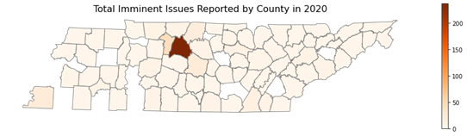
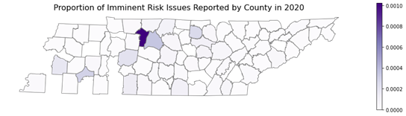
Tennessee by County: Imminent Risk Issues Reported
Davidson County has the most reporting of imminent issues by far.
When this is normalized by population, Cheatham county stands out, as well as Haywood, Chester, Davidson, Jackson, and Hickman counties.
Population density is included for reference and comparative purposes.
Notes:
Map3: Finally, we’ll look at the total number of imminent risk issues reported over all 2020 calls by county. There could be multiple issues reported in one call, so this means that we’re looking at the complete number of imminent issue reports. We see a lot of the same patterns as before, the counties that are distinct when this is normalized all appeared in one of the other two slides: Hickman, Cheatham, Haywood, Chester, and Jackson, and Davidson Counties.

Slide 33
Demographic Analysis
Notes:
Need to figure out what to call this section.

Slide 34

Key Considerations
Who is calling?
Age
Ethnicity
Gender Identity
Marital Status
Employment Status
How do crisis issues differ among these groups?
How are imminent risk calls distributed among these groups?
34% of callers did not supply ANY demographic info; 53% of callers supplied 1 of 9 demographic data points; 62% of callers supplied 2 of 9 demographic data points

Slide 35
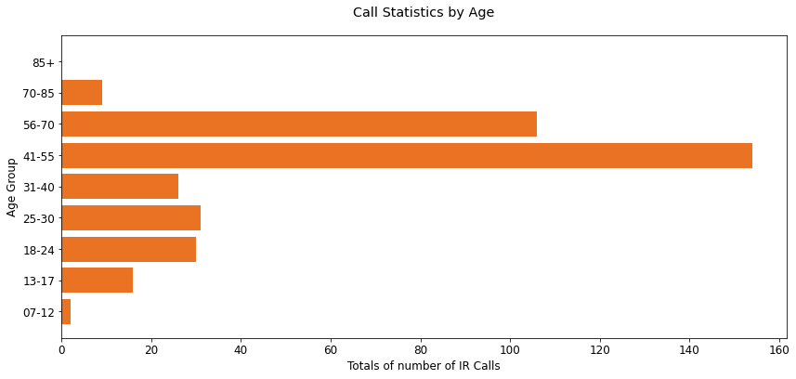
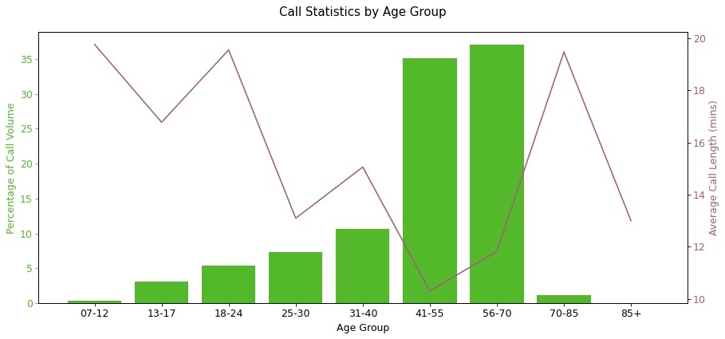
Demographics - Age
There is a large spike in the 41 - 55 and 56 - 70 age groups, which account for over 70% of the identified callers.
Overall Avg Call Length

Slide 36
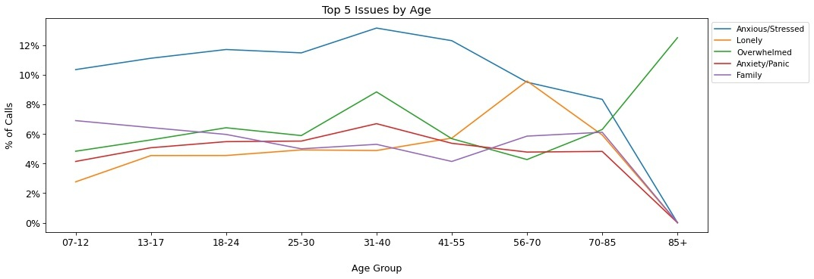
Demographics - Age

Slide 37
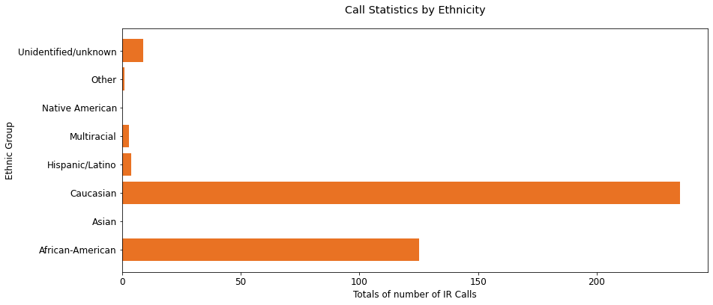
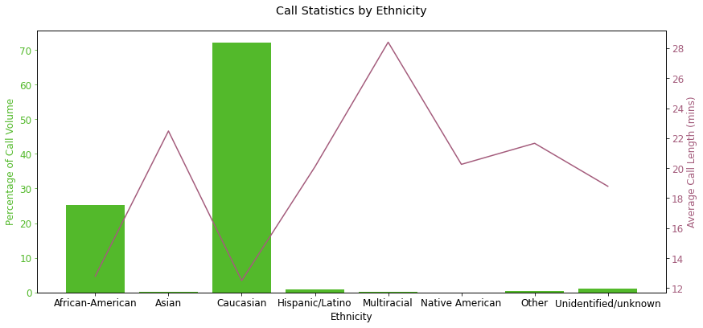
Demographics - Ethnicity
Caucausian and African-American callers combined for almost all of the callers (> 95%).
Other ethnic groups combined accounted for less than 5% of the identified callers.
Overall Avg Call Length

Slide 38
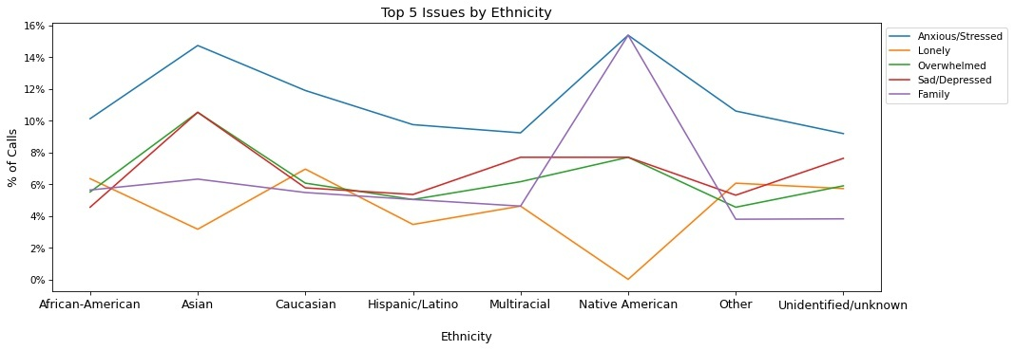
Demographics - Ethnicity

Slide 39
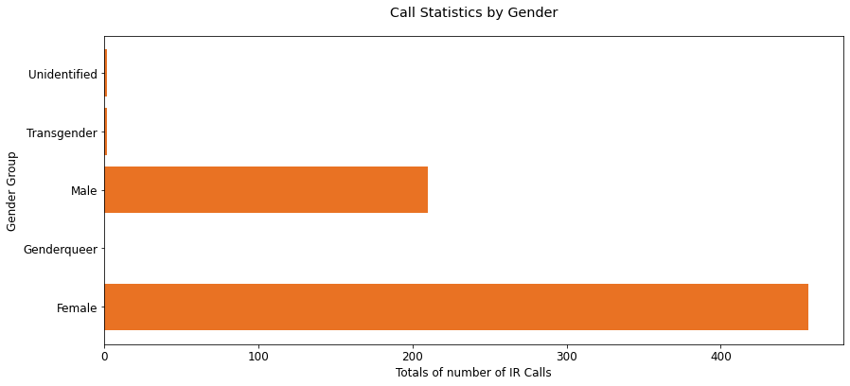
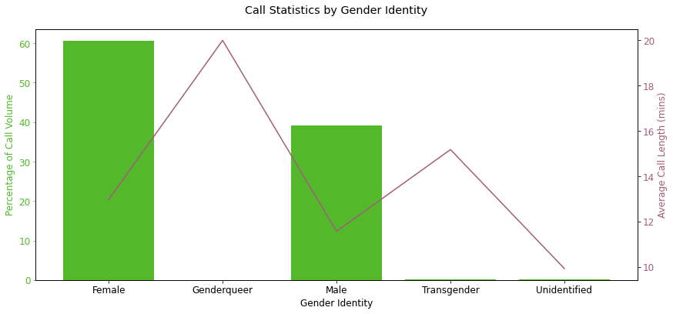
Demographics - Gender Identity
Female callers were a larger share than male callers at a 3:2 ratio.
Genderqueer, transgender, and unidentified callers made up less than 5% of callers.
Overall Avg Call Length

Slide 40

Demographics - Gender Identity

Slide 41


Demographics - Marital Status
Single and divorced callers accounted for the significant majority of callers, combining for over 90%.
Overall Avg Call Length

Slide 42

Demographics - Marital Status

Slide 43


Demographics - Employment Status
Roughly 55% of callers rely on some form of Social Security Disability Insurance (SSDI).
Overall Avg Call Length

Slide 44

Demographics - Employment Status

Slide 45

Demographics - Issue Categories

Slide 46


Demographics - Issue Categories

Slide 47
Analysis of Repeat & One Time Callers
Notes:
Need to figure out what to call this section.

Slide 48
Key Focus Areas for Analysis
Define the two types of callers, repeat callers and one time callers:
Repeat callers are individuals who call the center multiple times and have a unique Call Number assigned to them. One time callers are individuals who have not called the line before and have a -1 assigned to their Call Number.
Key focus areas:
Identify trends or patterns between types of crisis issues for both repeat and one time callers.
Explore time of calls made by repeat callers to determine if there are clear high or low volume time periods.
Determine how many calls are deemed as “imminent risk” and what the breakout is among repeat and one time callers.
Calculate how many minutes are spent on calls classified as “imminent risk” by repeat and one time callers.
Notes:
Jen’s notes:
Provide demographic breakdown of repeat callers
Count of high risk calls among repeat callers v. 1 time callers
Content of repeat callers as a whole
Chart over all times for repeat callers (time frames - Day (hourly). Month (daily/day of week), Year (monthly))
Look for trends in call frequency per person for the top 3-5 individuals.
Notes:
Would be good to know average call duration

Slide 49

Breakdown of Total Calls by Caller Type
58
Repeat Callers
15,254
One Time Callers

Slide 50


Breakdown of Total Calls by Caller Type
Repeat callers, or 58 individuals, accounted for 32% of total calls.
Repeat callers accounted for 30% of total call minutes in 2020.

Slide 51

Imminent Risk Calls by Caller Type
Almost 15K total minutes were spent on calls that were categorized as “imminent risk.” Repeat callers accounted for 22% of these calls.
202
Imminent Risk Calls by Repeat Callers
2,486
Minutes Spent with Imminent Risk Repeat Callers
732
Imminent Risk Calls by One Time Callers
12,295
Minutes Spent with Imminent Risk One Time Callers

Slide 52

Demographics of Repeat Callers
Gender:
33 female
21 male
4 unknown
Race:
35 caucasian
11 black
12 unknown
Disability status:
25 disabled
33 not disabled or status unknown
Marital Status:
26 single
3 married or cohabitating
12 divorced or separated
15 unknown

Slide 53

Repeat Callers by Hour of Day
The bulk of repeat callers call between 6:00am and 9:00pm
Most callers seemed to have “normal” sleep schedules
Our findings suggest an opportunity to increase staffing during the daytime hours, rather than the off-hours of the night.

Slide 54


Top 10 Crisis Issues by Caller Type
The top five crisis issues for the repeat callers and one time callers overlap for the following: Anxious/Stressed, Anxiety/Panic, Depression and Lonely

Slide 55
Imminent Risk & Value/Needs Analysis
Notes:
Need to figure out what to call this section.

Slide 56

High Imminent Risk Success Rate
Of 934 imminent risk calls identified in 2020, 928 were identified as successful. FCS has a 99.4% success rate for imminent risk calls!
934
Total Imminent Risk calls
928
Successful Imminent Risk calls
6
Unsuccessful Imminent Risk calls

Slide 57
If an imminent risk call is unsuccessful:
Person will likely go to the ER. The average cost for an emergency room visit in the US is ~$1,400.
If person is deemed a threat to themselves, they are placed in inpatient psychiatric care for 72 hours. Estimated cost is $800/day or $2,400 total. There are state psychiatric hospitals providing free care, however, space is usually limited.
If admittee can’t pay for care, cost is absorbed by healthcare company or city. These are real expenses.
Average cost of ER visit: $1,400
Estimated cost of 3-day inpatient psychiatric care:
$2,400

Slide 58

Low Emergency Dispatch Rate
Of 934 imminent risk calls identified in 2020, emergency rescue was dispatched only 17 times. FCS has an emergency rescue dispatch rate of 1.8% for imminent risk calls!
917
Imminent Risk calls with no emergency rescue dispatch
17
Imminent Risk calls with emergency rescue dispatched

Slide 59
Value and Unmet Need
917 imminent risk calls with no emergency rescue dispatch * $3,800 = $3,484,600 in healthcare savings created by FCS, making this program incredibly valuable!
In 2020, 16,620 calls or 36% of calls received, were not answered. Some of these may have rolled to backup locations.
Based on imminent risk call %, we can estimate that 339 imminent risk calls were among those received but not answered by FCS in 2020.
~$3.5 million
in potential healthcare savings created by FCS
16,620
Calls Unanswered
339
Estimated Imminent Risk
Calls Unanswered

Slide 60
Key Insights

Slide 61
Key Insights
Call volume:
Higher on weekdays than weekends
Most calls come between 6:00am and 9:00pm and average about 10 minutes
Political and weather events created swells in call volume rather than spikes
Call content:
Most common crisis categories are emotional states, mental health & relationships
The major issues of 2020 (especially COVID) remain ongoing ones. We can reasonably predict call volumes will stay high or possibly increase throughout 2021
Call location:
When normalized by population, we see an increase in calls, imminent risk calls, and imminent risk reports from Sumner, Jackson, Polk, Hickman, Cheatham, Hawkins, Haywood, and Chester counties. Davidson county maintains a relatively high concentration in all of these categories when normalized by population.

Slide 62
Key Insights (continued)
Caller demographics:
Callers were primarily middle-aged (41 - 70); Caucasian or African-American; traditional gender-labeled (Female, Male); Single or Divorced
Repeat callers:
Make up less than 1% of callers but constitute approximately ⅓ of call volume (both number of calls and duration of calls)
Represent 22% of imminent risk calls, showing that they are among the highest risk callers
The high rate of unanswered calls allows FCS to make a strong case for increased staffing
FCS can make a strong case (including to Healthcare companies) for increased funding by showing it saves nearly $3.5 million/year in avoided ER visits & inpatient psychiatric stays.

Slide 63
Questions?

